Slide 1
Cloud Computing Concepts

Slide 2
There’s a lot to know about the nuts and bolts of cloud computing.

Slide 3
Cloud Computing
Cloud Principles (25-30 mins)
Cloud Networking (45-50 mins)
Cloud Storage (35-40 mins)
Cloud Design (25-30 mins)
Duration – 2.5 hours

Slide 4
Cloud Principles

Slide 5


Overview
Introduction to cloud computing
Cloud vs. On-premise
Cloud service models
Cloud deployment models
Characteristics of cloud computing
Shared responsibility models

Slide 6
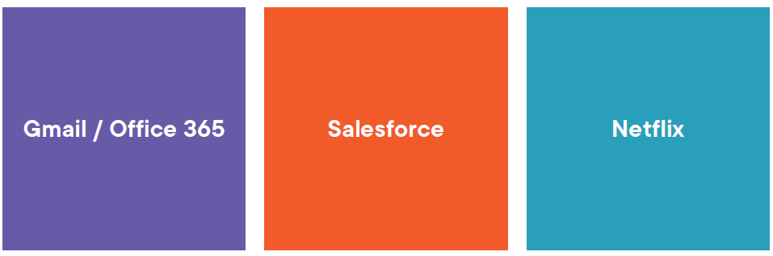
Cloud Services

Slide 7

Cloud vs On-Premise
Hardware Operating system applications
Traditional computing

Slide 8


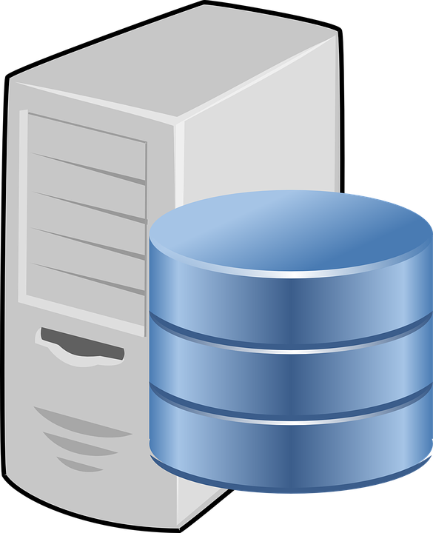

Expanding Company requirements
More employees – more computers
Buy expensive hardware
Spend time and resources for setup
Computers need to talk to each other
Need for a centralized storage / DB
Compute intensive applications
Every year, hardware gets obsolete
Companies keep building new features
OS and Application Upgrades

Slide 9

Keep up with the overwhelming pace at which requirements keep changing.

Slide 10
Cloud Computing
Computing services provided for you
Rent computer resources
Pay as you use
Flexible, scalable, reliable, available
Access to latest versions and updates
Enterprise level data protection
Reduced it staff / admin cost

Slide 11
Characteristics
Elastic – grow / shrink as per need
Resource pooling – divided among clients as needed
Rapid elasticity – fast allocation of resources
Self-service – automatically access any resources, at any time
Scalability - ability to use more or fewer resources
Broad network access - resources accessible over the network
Pay as you go – you pay for what you use and when you use it
Availability – resources are accessible when a client needs them

Slide 12

Pillars
Compute
Networking
Storage
Identity & Access management
Security

Slide 13
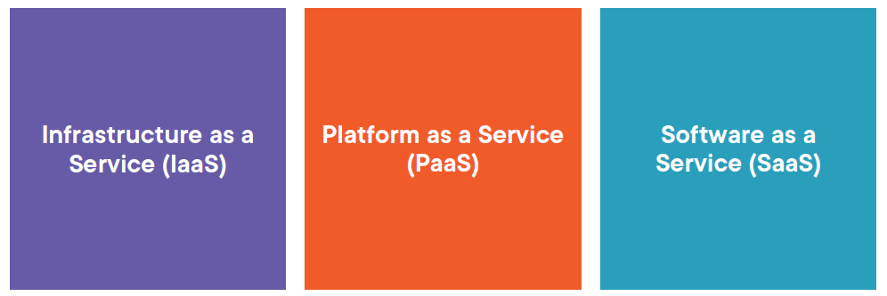
Models

Slide 14

Infrastructure As A Service
Virtual hardware replaces physical hardware
Scalable based on load
Pay for what you use
High performance computing
Data storage / backup and recovery
Resiliency
Guaranteed availability

Slide 15
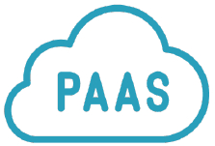
Platform As A Service
Allows developers to build and deploy applications.
OS and software
Runtime environment
Developers focus on app logic
Offers seamless app deployment
Load balancing & autoscaling
Apis, devops, ML …..

Slide 16

Software As A Service
Apps are accessed over the internet
It is the largest of the three models
Likely the one you are most familiar with
Monthly or yearly subscription fee
Internet connection is required
The biggest concern is data security

Slide 17

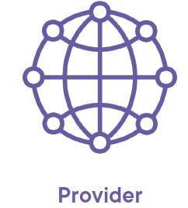
Shared Responsibility Model
Data and information stored in the cloud
Access security, meaning you only give access to those who need it
Devices that are allowed to connect to your cloud
Physical security, power, cooling, and network connectivity
The physical datacenter
The physical network
The physical hosts

Slide 18
Cloud Deployment Models

Slide 19
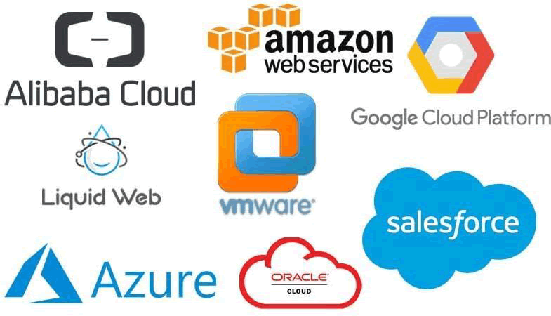
Public Cloud

Slide 20
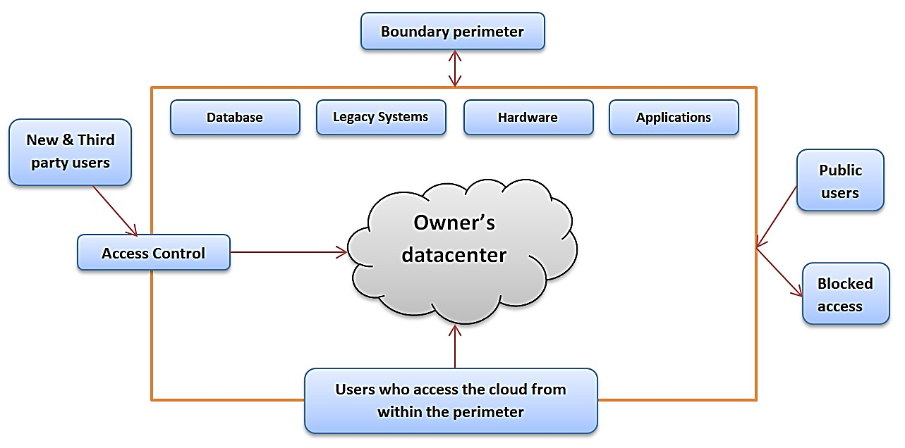
Private Cloud
Purchase virtualization software
Set up individual clouds
Within their own network
Limited scalability
Control all its own security

Slide 21
Hybrid Cloud
A computing model that integrates public cloud, private cloud, or on-premise infrastructure to run an organization’s workload and applications.
Use Cases
Public Cloud Migration
Cloud Bursting
Public cloud resources are utilized when the demand for capacity increases
Storage / Compute Bursting
Edge computing – pre-process data
Compliance use cases – when data needs to stay in a particular country or region
Data on-premise - cloud services computing

Slide 22
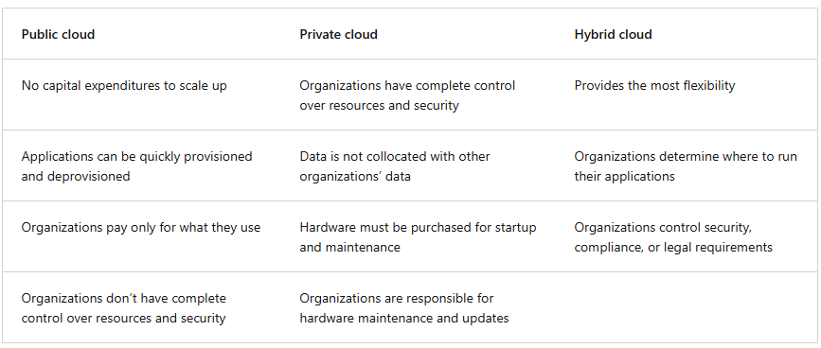
Comparison

Slide 23
Demo - Portal
https://portal.azure.com

Slide 24
Cloud Networking

Slide 25
Overview
Networking and protocols
Common access types
HTTP(S), RDP, SSH, VPN, and direct
Connect
Software-defined networking
Load balancing
DNS and firewalls

Slide 26
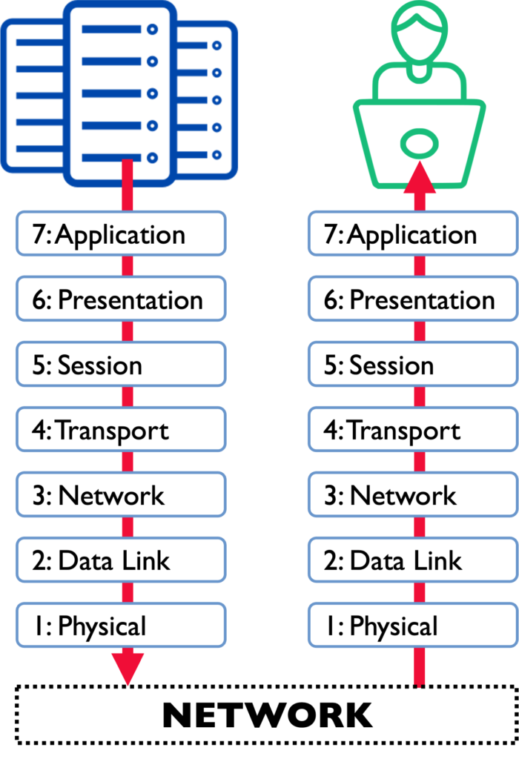
OSI Model
Open System Interconnection
Physical layer
Data link layer
Network layer
Transport layer
Session layer
Presentation layer
Application layer

Slide 27
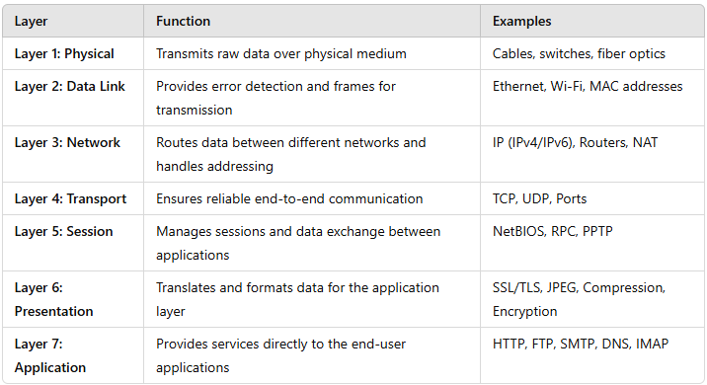
OSI Model Summary

Slide 28
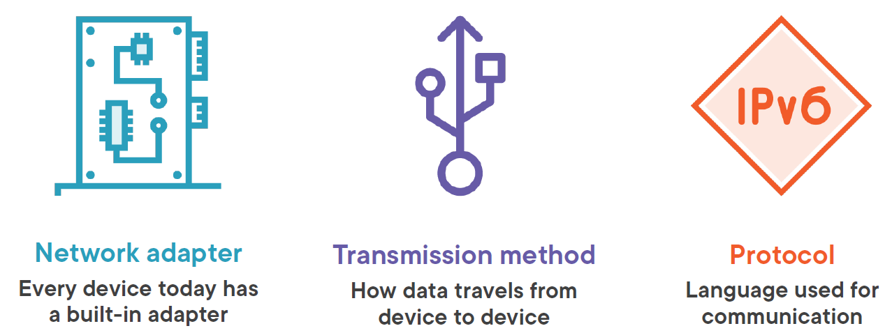
Networking

Slide 29
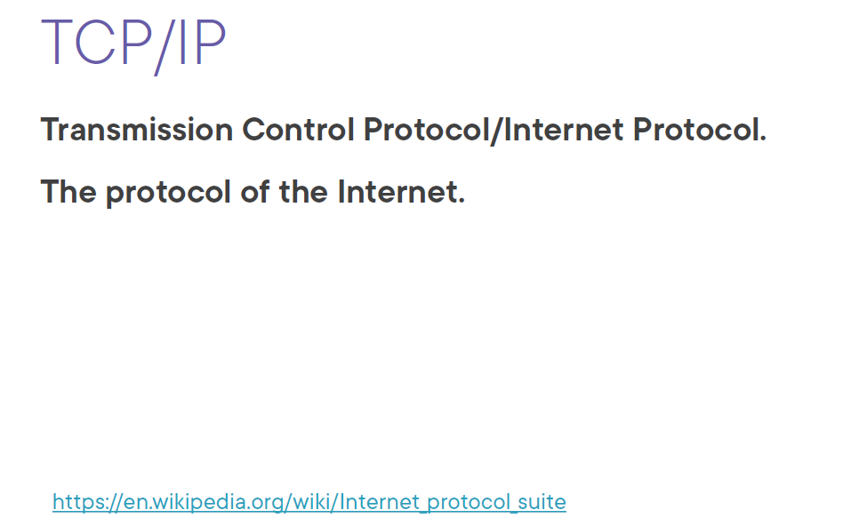
Protocol

Slide 30
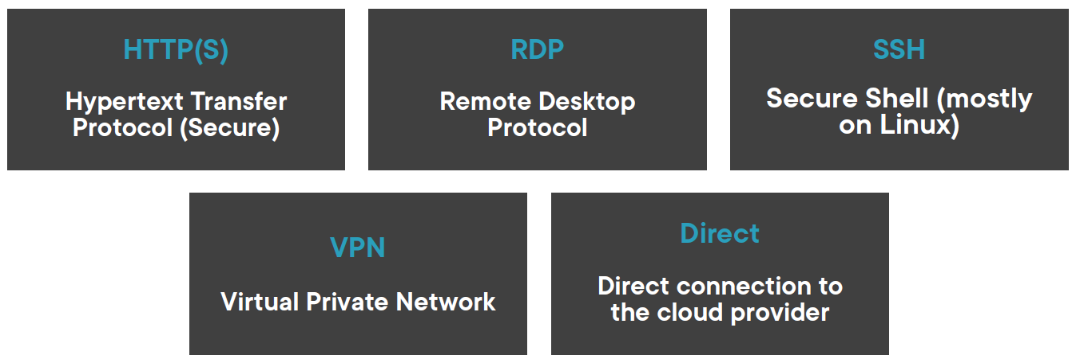
Access Types

Slide 31
Summary

Slide 32
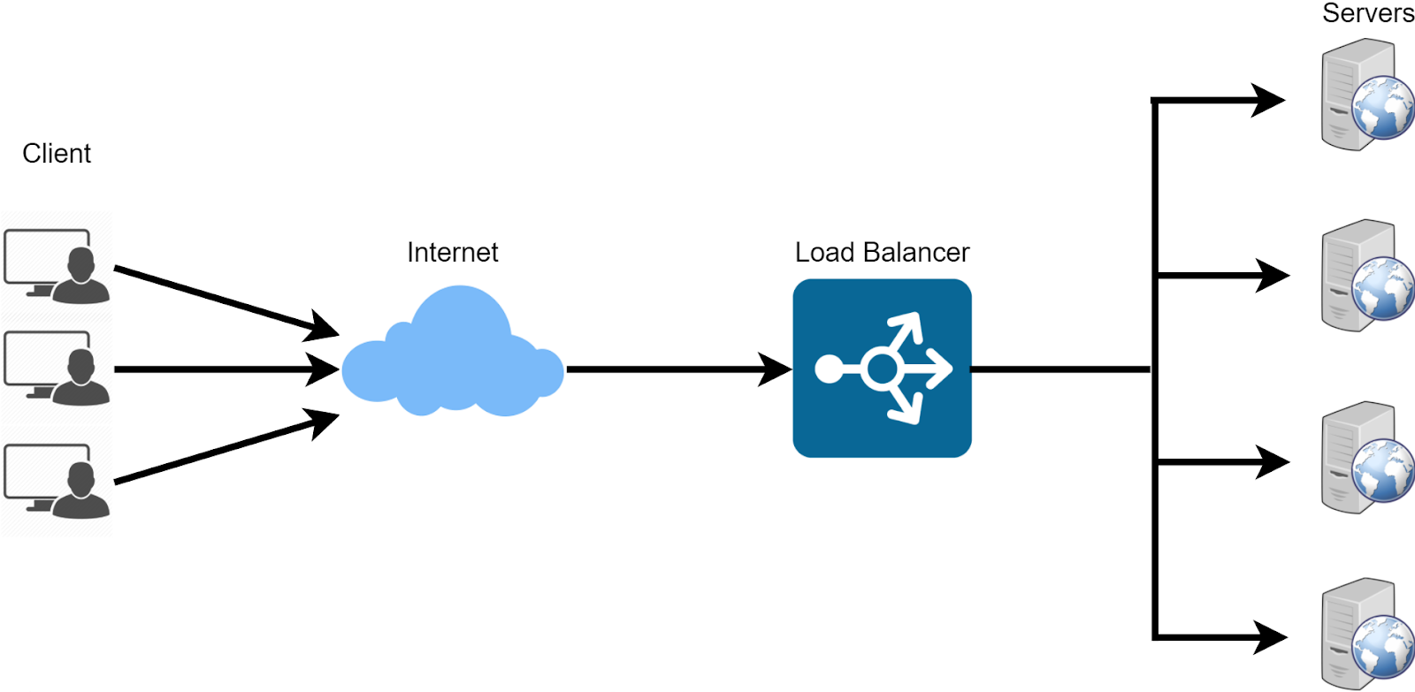
Load Balancing

Slide 33
Types
Application
L7
Makes routing decisions based on HTTP headers, URL, or application content.
Transport
L4
Makes routing decisions based on IP address and port number.

Slide 34
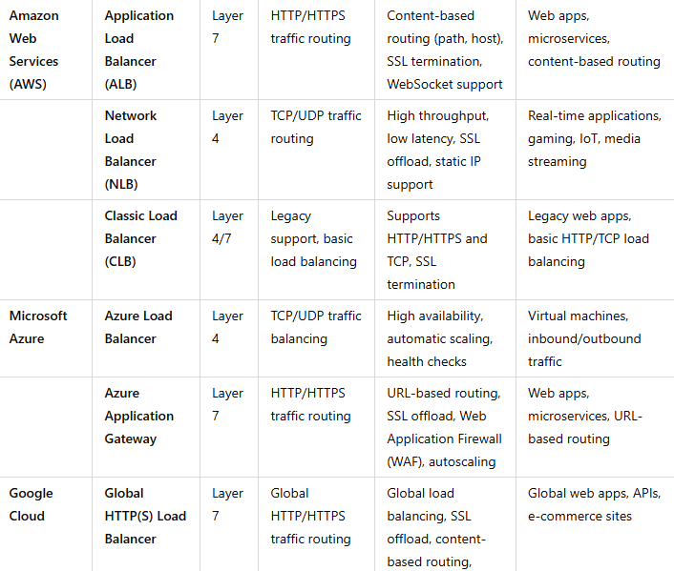
Cloud Load Balancing Solutions

Slide 35

DNS
Domain Name System
DNS Servers
DNS Records

Slide 36
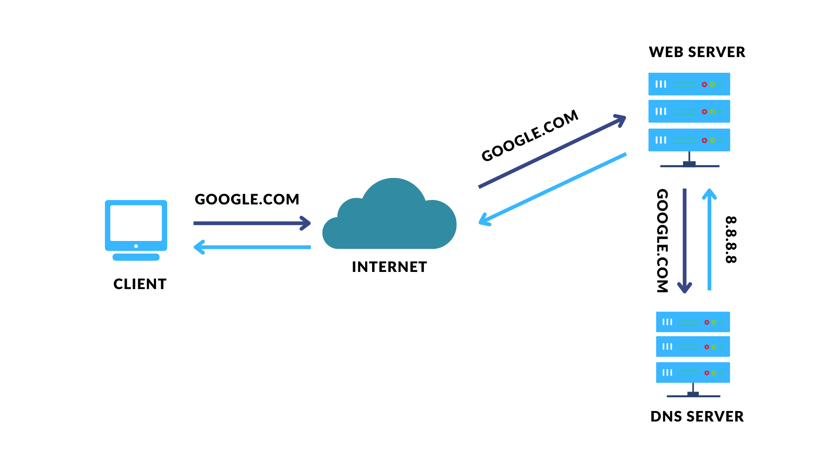
How DNS Works?
DNS translates the human-readable website names (such as "google.Com" or "amazon.Com") into numerical IP addresses, which the computers can understand.

Slide 37
1. Enter website address: you type a web address (URL) like "mypage[.]Com" in the browser.
2. Check local cache: your computer checks if it already knows the IP address from a local cache (browser, OS, or router).
3. Check host files: if not found in cache, your computer checks its host files for the IP address.
4. Ask DNS resolver: if still not found, it asks a DNS resolver (usually provided by your ISP).
5. Root server lookup: the DNS resolver asks a root server where to find the top-level domain (like ".Com").
6. TLD server lookup: the root server directs the resolver to the correct TLD (Top Level Domain) server (for ".Com").
7. Authoritative server lookup: the resolver asks the authoritative server for the exact IP address of "mypage[.]Com".
8. Get IP address: the authoritative server provides the correct IP address for the website.
9. Connect to website: your browser uses this IP address to connect to the website and load it.

Slide 38
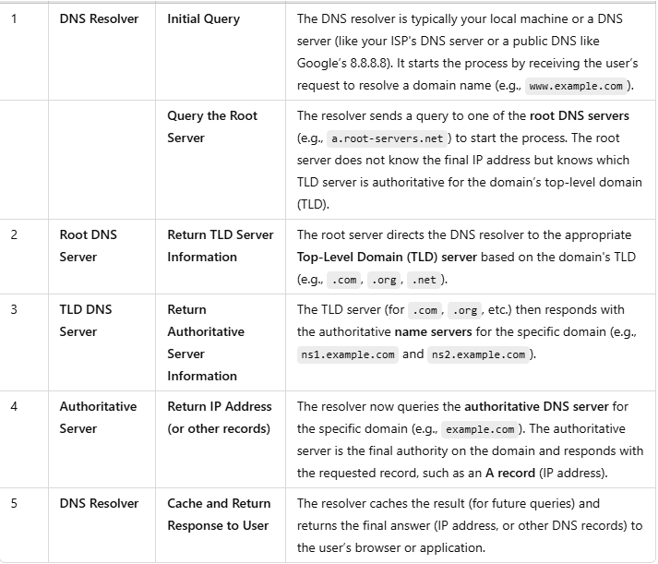
DNS Lookup

Slide 39
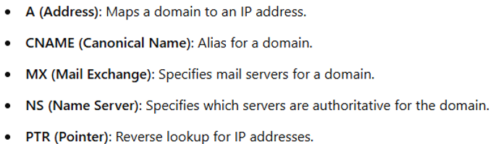
DNS Records
nslookup
dig

Slide 40
Cloud Storage
Understanding cloud storage
Storage characteristics
Storage types and features
Content delivery networks

Slide 41
DropBox
iCloud
Google Drive
One Drive

Slide 42
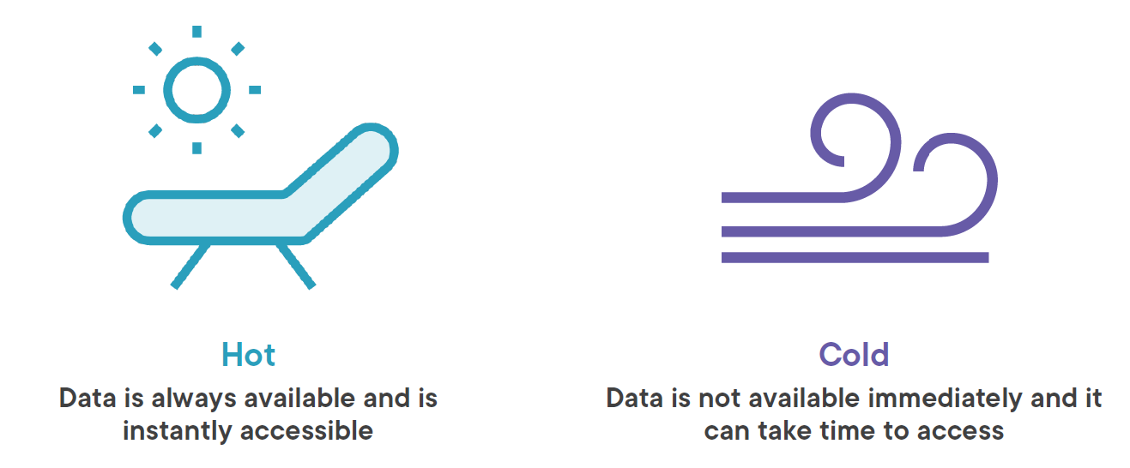
Access Types
Access frequency – frequent
Access speed – fast
Media type – SSD drives
Cost per GB - higher
Access frequency – infrequent
Access speed – slow
Media type – HDD
Cost per GB - lower

Slide 43
Storage Containers
Uploaded data is stored in a container
Providers allow multiple containers (file, blobs, tables)
They are called buckets or blobs
Flexible storage infrastructure
Use Cases:
Data Lakes: Large amounts of raw data are stored
Application Data: App-related data, such as user files or logs.
Content Delivery: Static assets (images, videos) for websites or apps

Slide 44
Characteristics
Cost Per GB
Storage Limits
Data encryption / compression
Read / write speed
Read / write costs
Data latency
Data retrieval cost
De-duplication

Slide 45
Demo

Slide 46
Content Delivery Network
CDNs give users the ability in remote areas to access data on servers that are closer than the main server is.
If the user is located far from that server, it will take a long time to load a large file, such as a video or website image. Instead, the website content is stored on CDN servers geographically closer to the users and reaches their computers much faster.

Slide 47
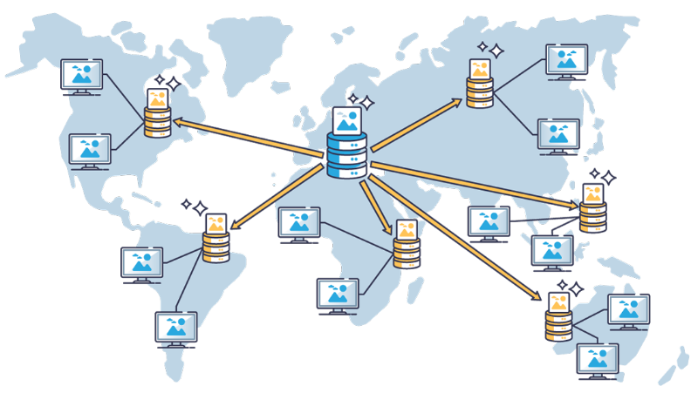
Caching
Data is cached at multiple edge servers close to user location

Slide 48
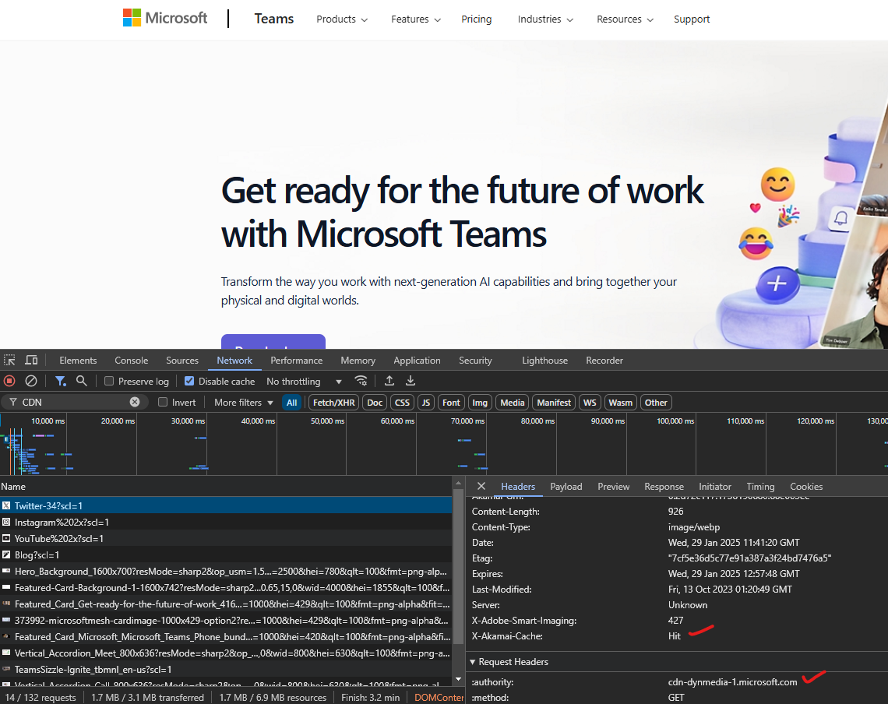
Benefits
Optimized Website Speed: Faster page loading times
Reduced Load on Your Server: Since a CDN helps distribute the load, it reduces the strain on your primary web server.
Better Content Availability: Users can browse your website, watch high-quality videos, download files, or retrieve information faster and more reliably.

Slide 49






Cloud Design
Redundancy
High availability
Disaster recovery
Recovery objectives

